Slide 1
اسبوع الفضاء العالمي 2023
الفضاء وريادة الأعمال

Slide 2
الفضاء وريادة الأعمال
الابتدائية الرابعة عشر تبوك
رقم الحدث : 65706

Slide 3
World Space Week
By General Assembly Resolution 54/68 of 6 December 1999, the General Assembly established World Space Week to celebrate the contributions of space science and technology to improving the human condition.
World Space Week is the largest annual space-related event in the world. It builds the workforce of the future by inspiring students, demonstrating public support for the space program, educating the public about space activities, and promoting international cooperation in space awareness and education. In 2018, more than 5,000 events were held in more than 80 countries to celebrate World Space Week.

Slide 4
Space and entrepreneurship
World Space Week 2023 focuses on the theme “Space and Entrepreneurship”, due to the growing importance of the space industry for commercial purposes, the growing opportunities for space entrepreneurship and the new benefits of space developed by astronauts. Small companies are now able to build and launch a small satellite, enabling entrepreneurs to create valuable new databases that benefit governments and also the space industry.

Slide 5
Space and entrepreneurship
World Space Week 2023 inspires students around the world to study science, technology, engineering, mathematics and business, and also provides an opportunity for space companies to recruit the workforce needed for the expanding commercial space industry. It will also serve as a forum for important discussions on transforming LEO into an entrepreneurial ecosystem.

Slide 6


Slide 7


Slide 8
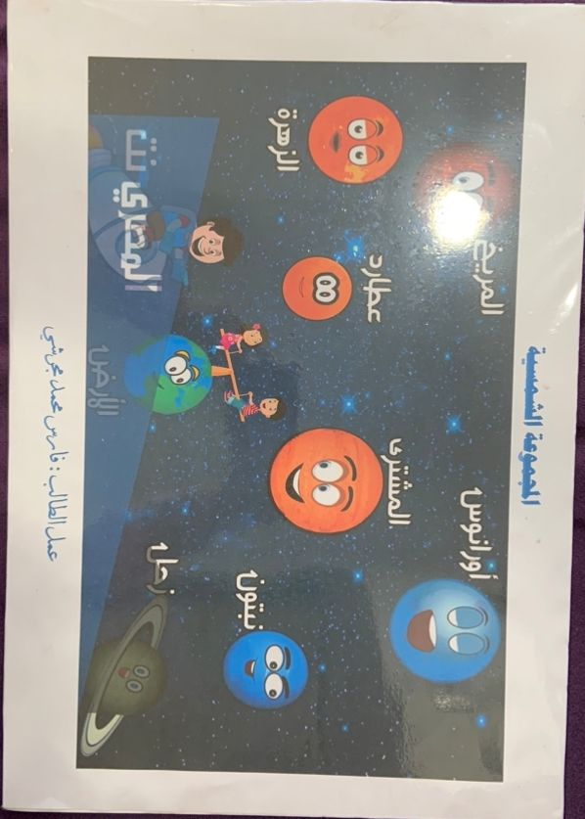

Slide 9


Slide 10
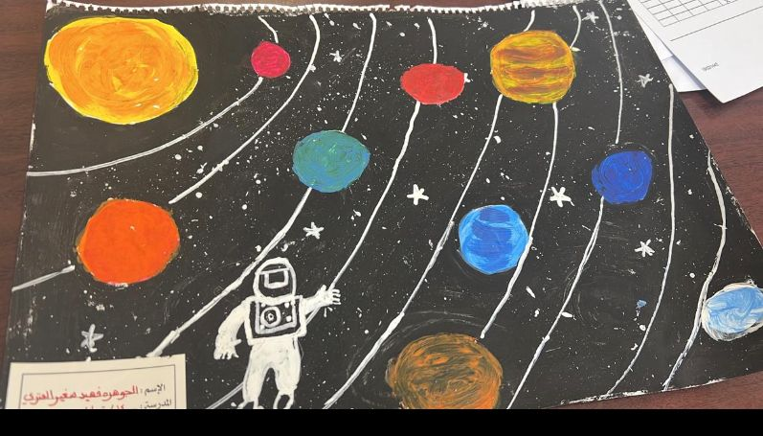

Slide 11


Slide 12


Slide 13


Slide 15


Slide 16


Slide 17
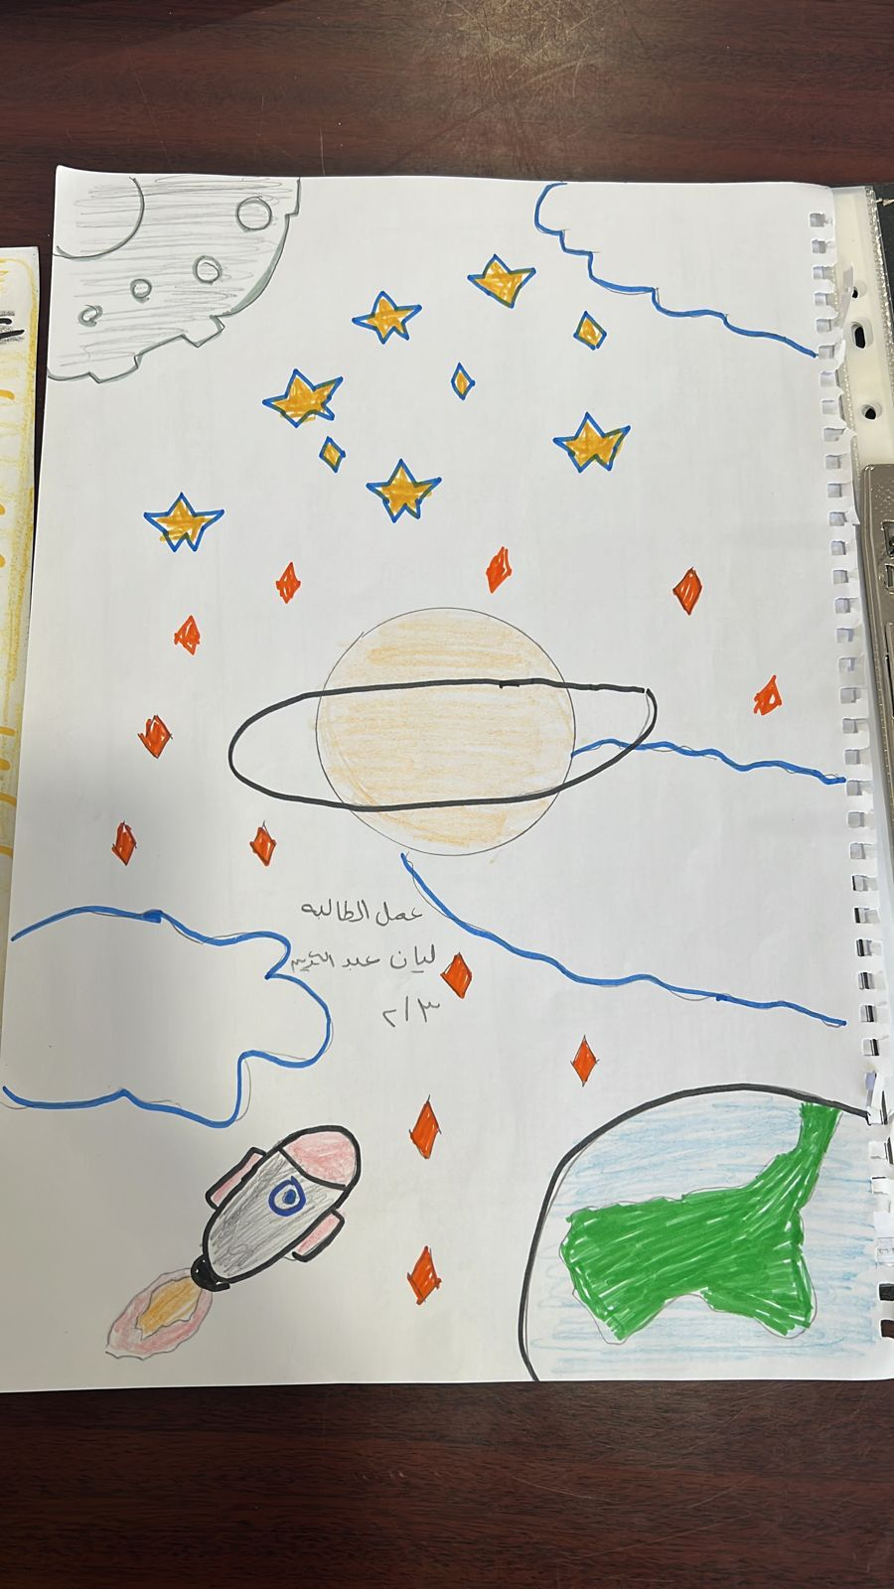

Slide 18
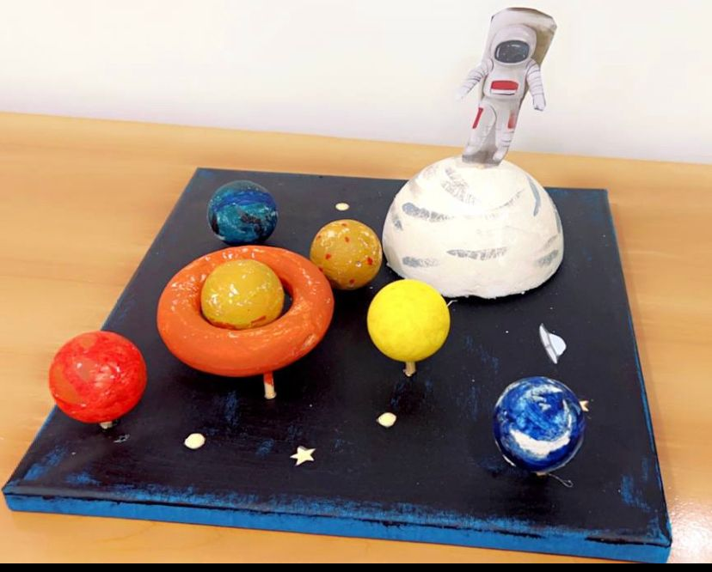

Slide 19
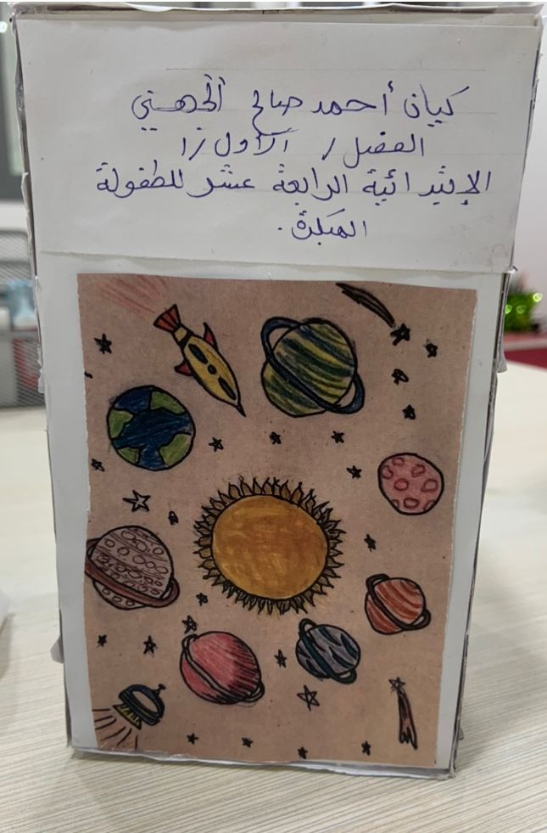

Slide 20
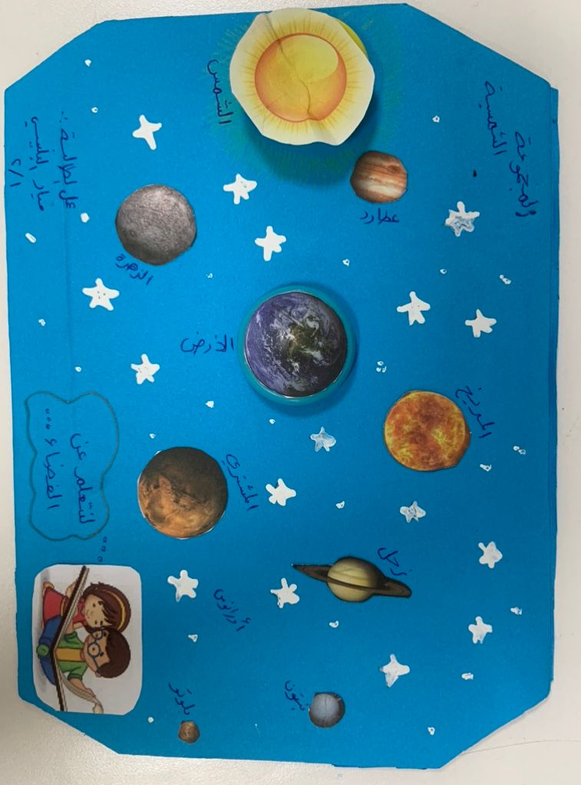

Slide 21


Slide 22
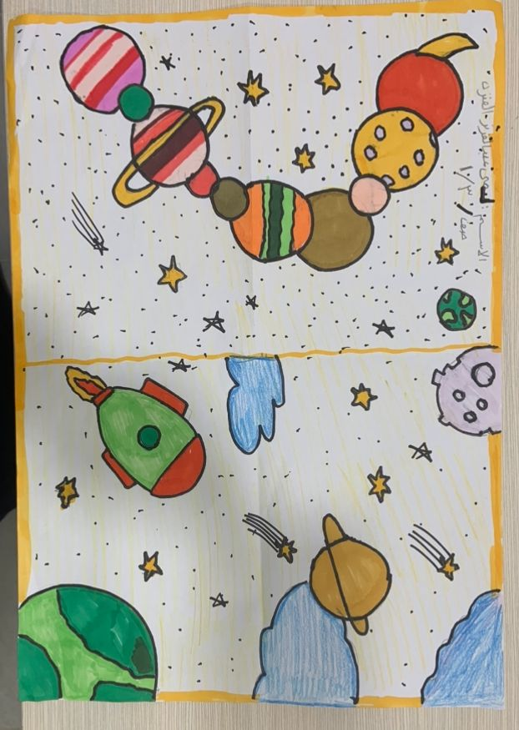

Slide 23


Slide 25
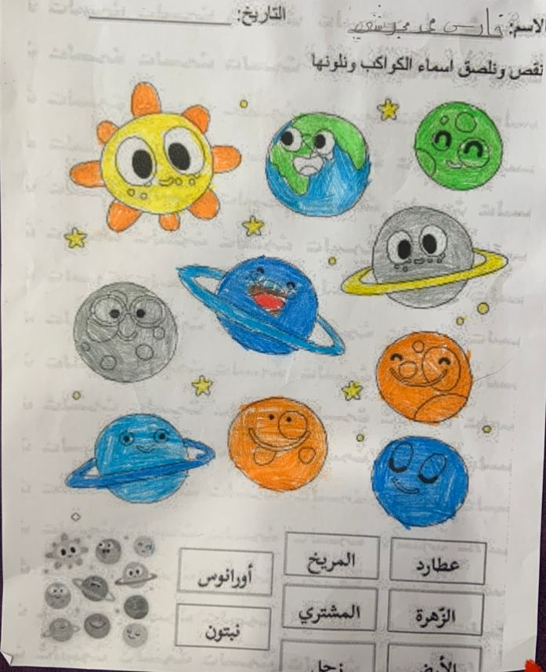

Slide 26
